Slide 1
e-DISCOVERY AND
INFORMATION MANAGEMENT
INFORMATION WITHOUT BORDERS CONFERENCE
February 7, 2013

Slide 2
Overview
Introductions
Litigation Scenario
Preservation
Production
IM Perspective
Q&A

Slide 3

Mapping it Out

Slide 5
The Client Meeting

Slide 6
Guess what happens next…
Client
Lawyer

Slide 7
R. 16.02:
The Duty to Preserve
(2) A party who becomes aware that a proceeding is to be defended or contested, must take measures to preserve relevant electronic information

Slide 8
Electronic Information
… means a digital record that is perceived with the assistance of a computer as a text, spreadsheet, image, sound, or other intelligible thing
and it includes metadata associated with the record and …
a record produced by a computer processing data, and …
Notes:
This is from Rule 14.02 – definitions that relate specifically to e-disclosure and e-discovery

Slide 9
Examples of Electronic Information
(i) an e-mail, including an attachment and the metadata in the header fields showing such information as the message’s history and information about a blind copy,
(ii) a word processing file, including the metadata such as metadata showing creation date, modification date, access date, printing information, and the pre-edit data from earlier drafts,
(iii) a sound file including the metadata, such as the date of recording,
(iv) new information to be produced by a database capable of processing its data so as to produce the information;
Notes:
This is still part of the same rule – the emphasis is on not just the information you would ordinarily look for but on all the kinds of meta-data that might go with it that would tell you about the creation or alteration of the document.

Slide 10

Electronic Information
Notes:
Pretty much the definition relates to anything you can view on a computer, and any of the file or properties information or other meta-data related to it
So then the question is which electronic information needs to be preserved…

Slide 11
Duty is to Preserve ESI that is…
16.02 (a) readily identifiable:
(You can find it pretty easily on a computer.)
Notes:
ESI – Electronically Stored Information
16.02(a)
Under the file name
With the other file materials
Under the name of a key party, or description of the venture
Where one of the players usually keeps that material
Can find it using keyword searches
So that’s good news, you don’t have to look in every nook and cranny. You just have to look where you would expect to find information related to the matter in issue.

Slide 12
R. 16.02(b)
(b) accessible by the party to the exclusion of another party…:
(An employee of the province has the password to get to it - even if its not on our computer)
Notes:
(e.g. someone else hosts a database for us)

Slide 13

Paper or Electronic Copies
Contracts and drafts
Correspondence
Emails with attachments
Spreadsheets
Financial statements
Log notes
Notes:
More and more people are not printing the documents they create. And the volume of emails has grown exponentially. So IM people need to know where everyone’s files are – and generally that’s ok for paper, but for electronic files, you may need the help of IT to locate all of the relevant directories. Usually emails are stored on a separate server than the word processed documents. Databases usually have their own server. The documents could be in the cloud.
In our paper world, preserving documents is easy - records people have protocols for litigation holds, marking the retention schedule to ensure the record is not destroyed - but how are electronic documents actually preserved?

Slide 14

Notes:
No, this is not the next step! In fact we discourage self-help
You need an IT professional, The lawyer, the IT person and the records person have to work closely to ensure all of the relevant electronic information and paper records are preserved.

Slide 15
“Exactly Copy”
16.02(4) The party must exactly copy the relevant electronic information required to be preserved, unless the parties agree or a judge orders otherwise
Notes:
The rules require the party to “exactly copy” the relevant electronic information that is to be preserved

Slide 16
What is “exactly copy”?
“exactly copy” means to make an electronic copy of electronic information in such a way that the copy is a mirror image of the original in a computer, storage medium, or other source
Notes:
(14.02(1)(iv) need to read R 14 with R 16)
The intent is that you have an exact duplicate including the meta-data

Slide 17
Mirror Image
Do NOT copy the documents
Do NOT do this yourself
TRY to keep the requester from ‘helping’
DO have the requester contact their IT Department
You need a PROFESSIONAL!!!

Slide 18
Preservation Guidelines
Issue a timely litigation hold notice
Ensure that legal holds are worded clearly and carefully
Carefully identify the "key players" in a matter

Slide 19






Identify data sources for preservation

Slide 20
More Preservation Guidelines
Be thorough in preserving documents
Suspend routine document destruction:

Slide 21
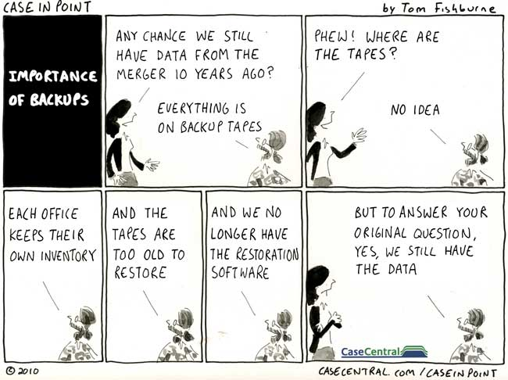
We always have our backup tapes…
Notes:
Used with permission of Case in Point

Slide 22
And Even More…
Monitor compliance with litigation holds (and subsequent ones)
Leave a paper trail
Reasonableness and proportionality are important considerations, but not necessarily guiding principles in every court

Slide 23

But that’s not all…

Slide 24
Production of Documents
Based on Sedona Canada Principles
Proportionality is key
  What is the scope of the issues in the litigation?
  What will be the cost, burden or delay of collecting the e-docs?

Slide 25
Affidavit Disclosing Electronic Information (Corporation)
Must attach Schedule A, describing each discrete item of electronic information according to:
  a number identifying the document
  date of creation
  type of communication or other information (email, letter, spreadsheet…)
  author (and maybe the company) and
  Recipient (and company)

Slide 26
R. 16.09(3)(d):
Exchange of Affidavits
Affidavit to be provided in print and in a readily exchangeable electronic format.
Notes:
So if you receive the documents electronically, you have to send them electronically to the other side unless the lawyers agree or the court orders otherwise
But note the “readily accessible” - Wordperfect documents and Groupwise email may not be “readily accessible” to people with Word and Outlook – we may have to convert some of our electronic documents to something the other side can read.

Slide 27
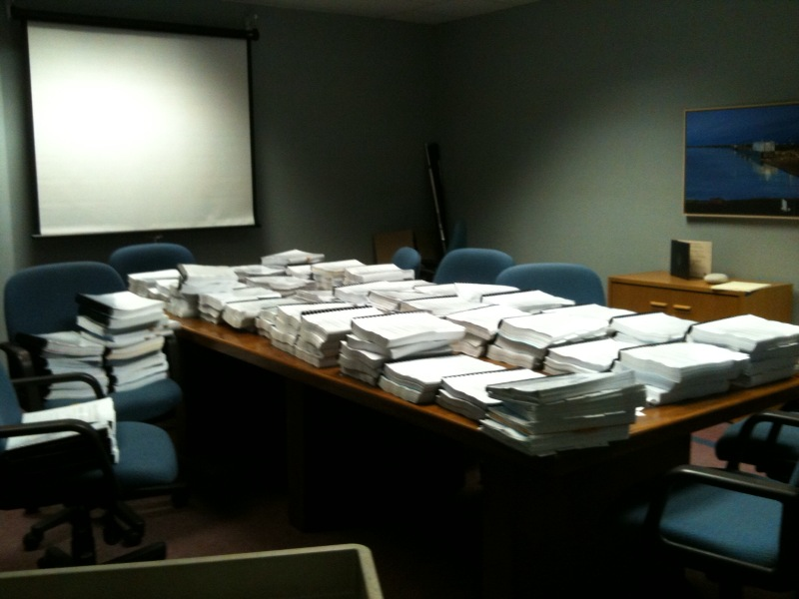
Introduction
The Policy on Collaboration and Communication Between Litigators and Solicitors
D.Bartol and S.McGrath preparing for DMC
outlines the expectations for communication and collaboration between litigators and solicitors in the provision of client services
Shared directory location
S:\Legal Services\Projects\communications priority-10-11\communications policy litigator solicitor 2011 07 15.docx

Slide 29
e-DISCOVERY AND
INFORMATION MANAGEMENT
INFORMATION WITHOUT BORDERS CONFERENCE
February 7, 2013

Slide 30
Information Management and e-Discovery
Identify
  Information Management is foundational for e‑discovery
Produce
Locate
Information Management
Preserve
Access
Authenticate

Slide 31
Information Management and e-Discovery

  Information Management Professionals play an important role in the e‑discovery process

Information Management Professionals


▪

Slide 32
Information Management and e-Discovery
* policies * policie * policies
standards
  Information Management provides the necessary tools and services in support of e‑discovery
Tools
practices
IM

Slide 33
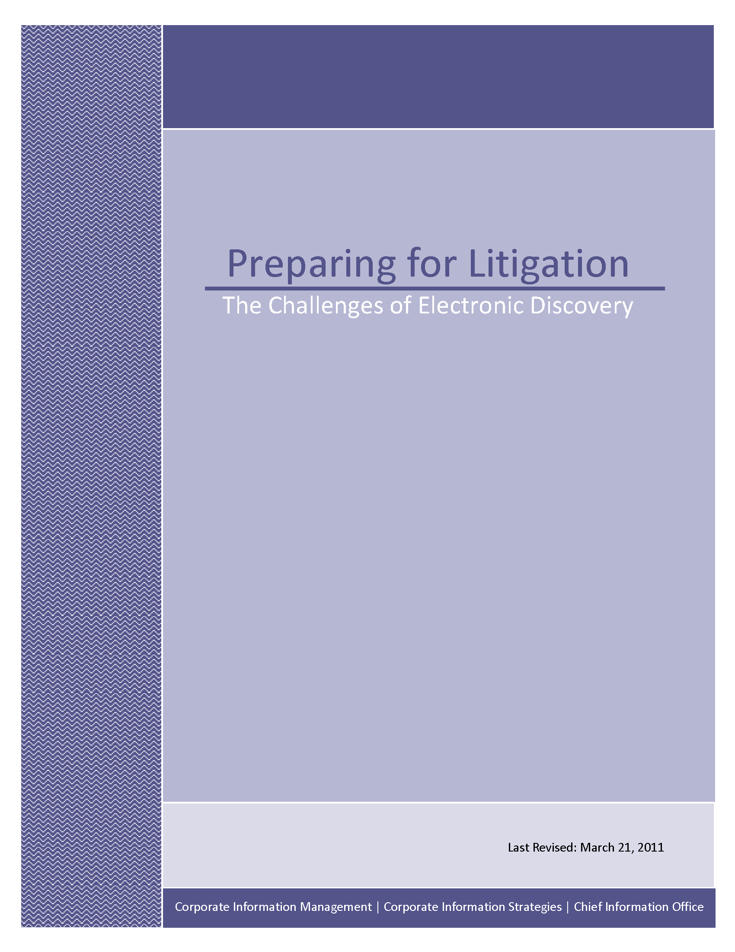
Information Management and e-Discovery
  Research Paper

Slide 34
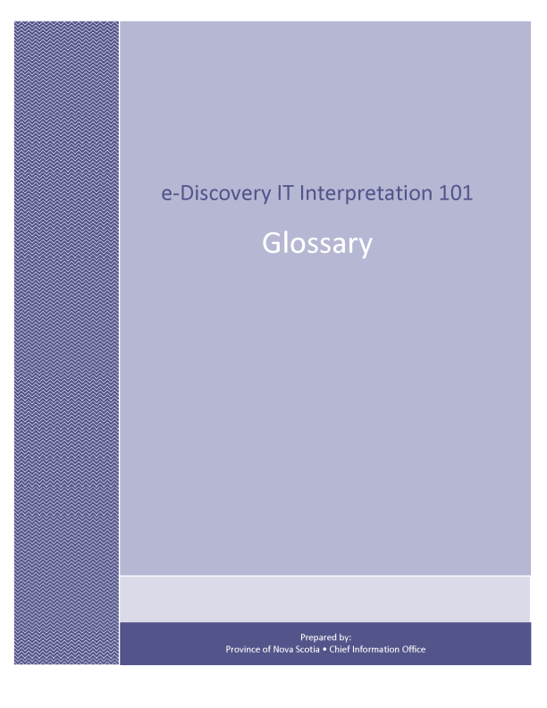
Information Management and e-Discovery
  Glossary of Terms

Slide 35
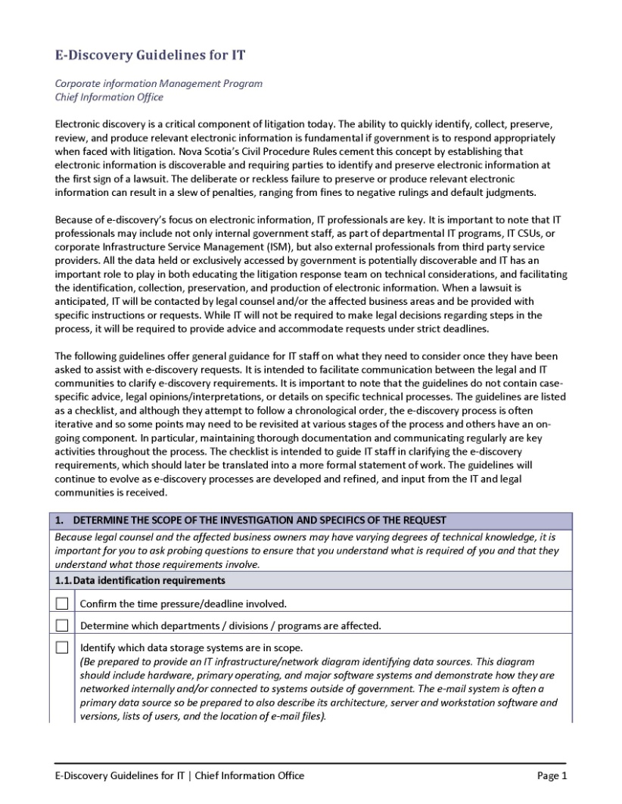
Information Management and e-Discovery
  Guidelines for IT

Slide 36
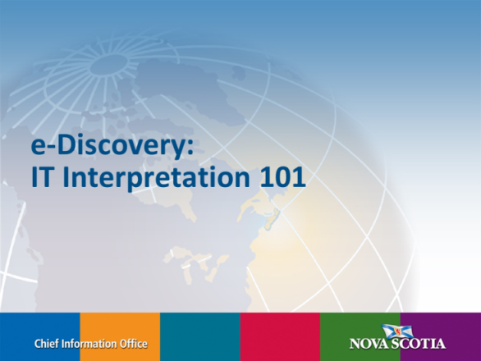

Information Management and e-Discovery
  Ongoing Training

Slide 37



Information Management and e-Discovery
  e‑Discovery is a growth area providing opportunities for new IM professionals
Research
Projects
Technology & Software

Slide 38
Notes:
Questions?

